Slide 1
Spring workshop
Karthikeyan Bollu Ganesh
Michael Inden
ASMIQ Academy

Slide 2
Contents
Introduction
Spring Framework I
Spring Architecture
Dependency Injection
DI/IoC in Spring
XML Configuration
Java Configuration
Exercises
Annotation Configuration
STS Suite / Plugin + Live Demo

Slide 3
Contents
Spring Framework II
Web-MVC
Exercises
Spring Boot I
Introduction
Spring Initializr
REST Service with Spring-Boot
Spring Dev-tools Demo
Testing
Exercises
Bean Scopes
Bean Lifecycle
Laziness

Slide 4
Introduction

Slide 5

Father of Spring

Slide 6
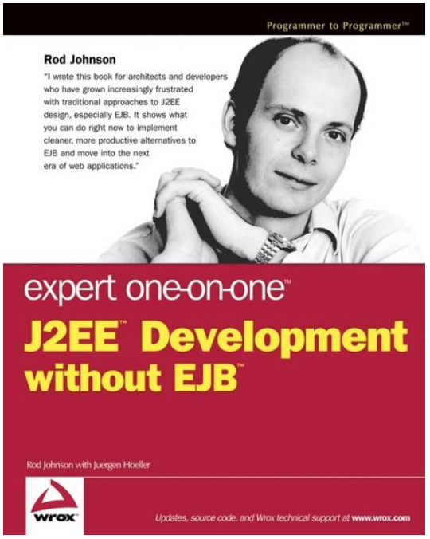
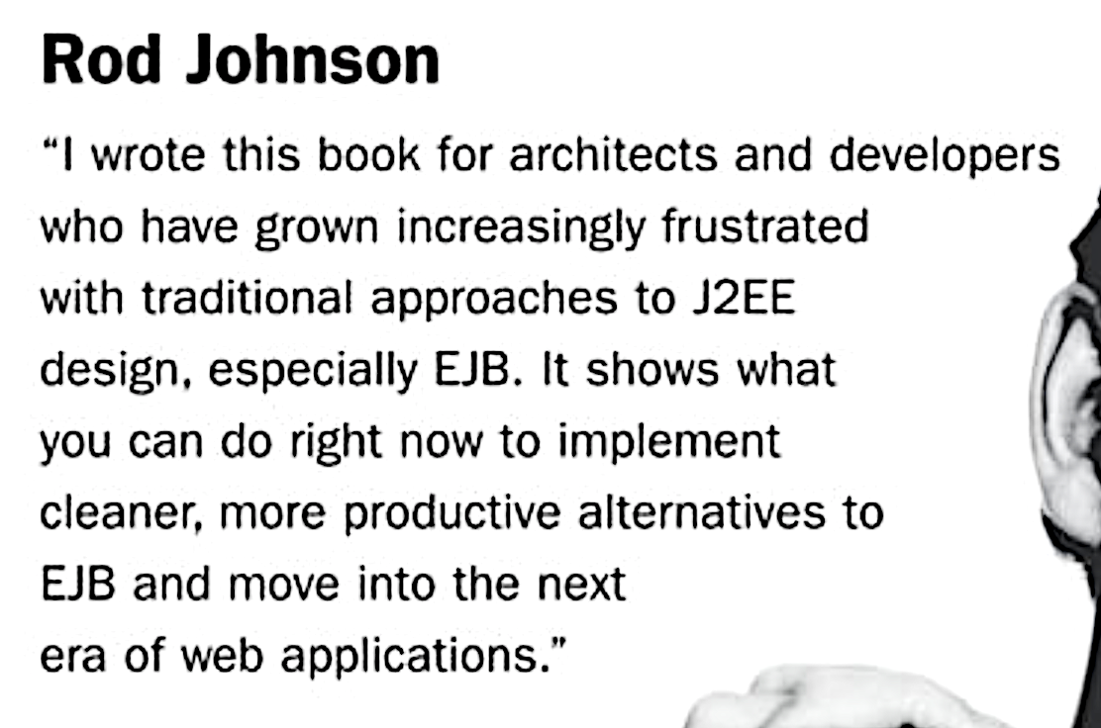
Spring‘s birth

Slide 7




Spring‘s birth
V 0.9
Notes:
Rod Johnson wrote this book on 2002 with describes the complexities of the EJB and he wrote all the infrastructure code for the dependency injection in the package com.interface21. Later Jürgen Höller requested him to create a open source framework based on this infrastructure code, which gave birth to the Spring framework.

Slide 8




Spring‘s growth
4.0
5.0
2.0
3.0
1.0
Version
2003
2006
2009
2013
2017
Year

Slide 9




Spring company‘s growth
2002
2008
2009
2013
Year
Notes:
In April 2013 VMware, and its parent company EMC Corporation, formally created a joint venture (with GE) called Pivotal Software.

Slide 10
Spring - Benefits
Light weight
Just POJO – need not implement/extend any framework interfaces/classes
Modular
Include just the needed module to use the needed functionality.
For DI just include spring-context
Non-intrusive
domain logic code generally has no dependencies on the framework itself
Notes:
Light weight/ Non-intrusive: POJO means Plain Old Java Object. It refers to a Java object (instance of definition) that isn't bogged down by framework extensions. -> https://spring.io/understanding/POJO
Modular: We do not all of the spring‘s modules to create an app. Forexample to use the DI functionality in our web-app, we can just add the spring-context module.

Slide 11




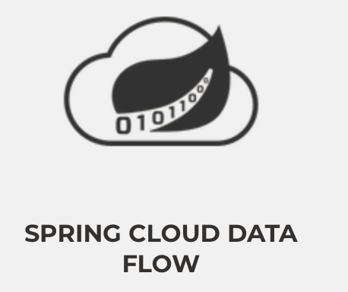



Major Spring Projects
Notes:
Change the Picture sizes
framework, boot, data, batch, cloud, cloud data flow, integration, security.

Slide 12


Spring Framework - JDK Baseline
Version | JDK 6 | JDK 7 | JDK 8 | JDK 9 | JDK 10 | JDK 11 | JDK 12
4.3.x
5.0.x
5.1.x
Notes:
JDK6 and JDK7 - Grey
JDK 8 LTS , JDK 11 LTS - Blue colour

Slide 13
Spring Framework 5 + JDK 9 Module
Does Spring Framework 5 work with the new Java 9 module system?
Yes, Spring Framework 5 ships with automatic module name entries in the manifests of our Spring Framework 5 jars. The public API surface of the Spring libraries remains unchanged.

Slide 14
Spring Framework I

Slide 15
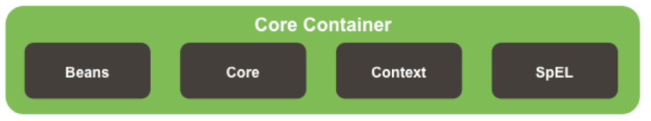
Spring Architecture

Slide 16
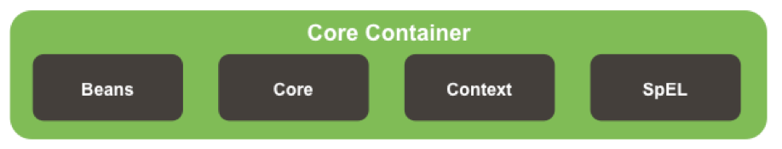



Spring Core Container Details

Slide 17
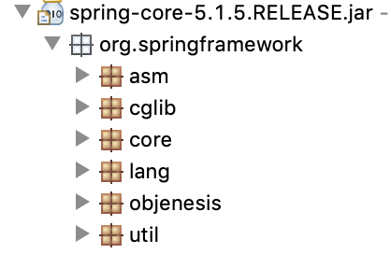
Core Module
Notes:
ASM – bytecode Manipulation and Analysis Framework
Cglib – bytecode generation library
Core – contains classes for exception-handling and for detecting the versions etc.
Lang – classes to mark the version info
Util – classes for logging configs, string manipulations etc.

Slide 18
Beans Module
Contains necessary classes and interfaces for the manipulation of the java beans
Defines most important interface like BeanFactory for Dependency Injection.
Includes utility functions for checking property types, copying bean properties, instantiating java beans.

Slide 19
Context and SpEL Modules
Context
Defines the interface ApplicationContext, which extends BeanFactory
Spring Expression Language
“Language to query and manipulate the object graph at runtime.“
#{object.property}
#{object.subobject.property}

Slide 20
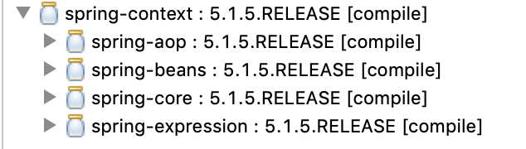
Core Container Module

Slide 21
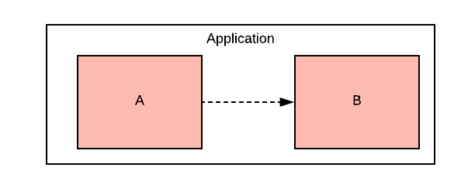
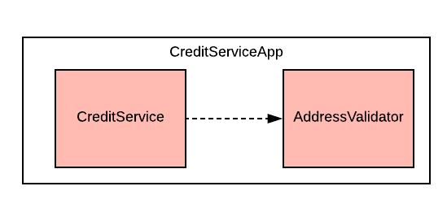
Dependency
Notes:
To provide the creditservice functionality the app depends on the validation of the address.
In crude form:
When an object A needs/uses another object B to provide a functionality of an application, then Object A is dependent on Object B

Slide 22
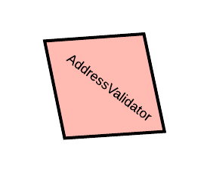
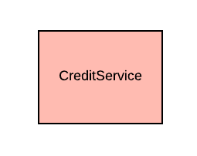


Slide 23
Dependency Injection
The process of introducing the dependency to the dependent object is called dependency injection

Slide 24
Dependency Injection
public class CreditServiceApp {
public static void main(String[] args) {
var addressValidator = new AddressValidator();
var creditService = new CreditService(addressValidator);
creditService.dispatchCredit();
}
}

Slide 25

Manual Dependency Injection
public class CreditServiceApp {
public static void main(String[] args) {
var addressValidator = new AddressValidator();
var creditService = new CreditService(addressValidator);
creditService.dispatchCredit();
}
}
Manual DI

Slide 26
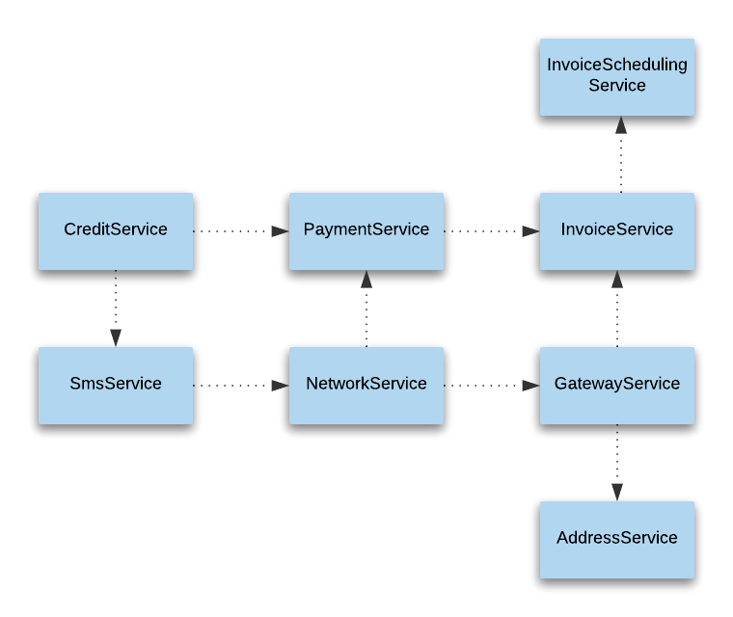

What if ?

Slide 27
Manual DI Problems
A depender knows the internal details of the dependee
Not easily testable
Tight Coupling
Hinders the code readability
Lot of manual object instantiation & boiler-plate codes
Notes:
The more the dependencies, the more the modifications in code
A depender knows the internal details of the dependee
Example - SmsService -> MobileSubscriptionService
In this case -> SmsService has to know how to create MobileSubscriptionService
Not easily testable
Without resolving all the dependencies it is almost impossible to test the NotificationService.
Tight Coupling
Changes in the construction logic of the dependee results in the changes in the construction of the depender.
Hinders the code readability
The instantiation logic are scattered, which prevents the smooth flow of understanding the actual functionality

Slide 28

Solution for manual DI Problems
having an agent/factory/framework/x
to instantiate the dependee objects
resolve the dependencies

Slide 29
IoC / DI
The process
of letting out our control in the instantiation of dependent objects and configuring the object graph is Inversion of Control (IoC)
of resolving the dependencies is called Dependency Injection (DI)

Slide 30

Dependency Injection in Spring

Slide 31



Spring Bean
Plain Old Java Object (POJO) which is/will be managed by the Spring is called Spring Bean.
SimpleCar Bean
Spring
SimpleCar

Slide 32
IoC Container
Is also an object
manages other objects
enables Dependecy Injection
builds Object Graphs

Slide 33
IoC Container
D
C
Spring
A
B

Slide 34
IoC configuration metadata
The information needed to configure the IoC Container is Configuration Metadata

Slide 35

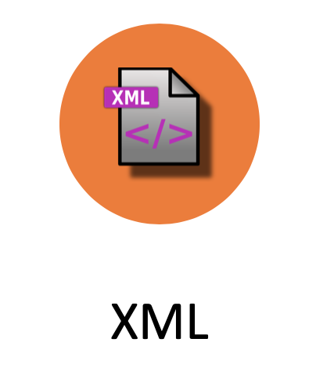

Configuration metadata types
XML
Java
Annotation

Slide 36

XML Configuration
<?xml version="1.0" encoding="UTF-8"?>
<beans xmlns="http://www.springframework.org/schema/beans"
xmlns:xsi="http://www.w3.org/2001/XMLSchema-instance"
xsi:schemaLocation="http://www.springframework.org/schema/beans http://www.springframework.org/schema/beans/spring-beans.xsd">
<bean id=“person" class=“ch.karthi.Person">
<property name=“name“ value=“karthi“ />
<property name=“age“ value=“22“ />
</bean>
</beans>

Slide 37

Java Configuration
@Configuration
public class MyConfig{
@Bean
public Person createPerson(){
Person person = new Person();
person.setName(“karthi“);
person.setAge(“22“);
return person;
}
}

Slide 38

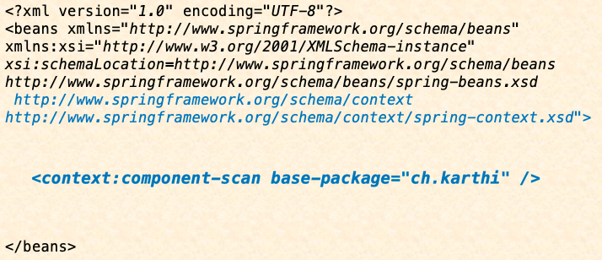

Annotation Configuration
@Component
public class Person {
...
}

Slide 39
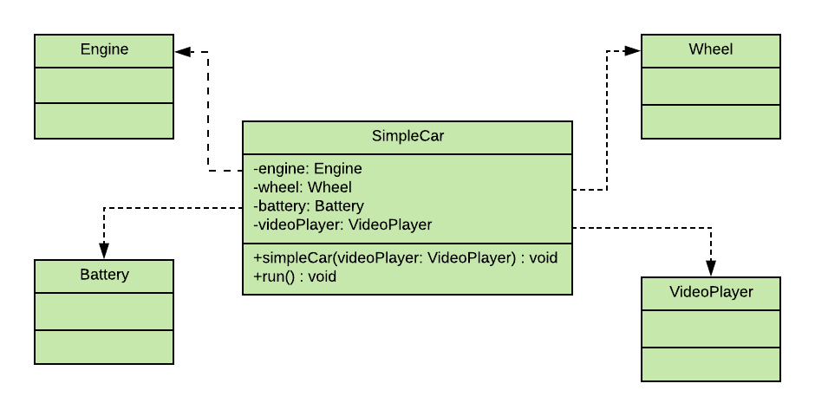
XML Configuration

Slide 40
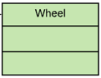
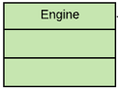
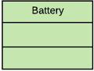
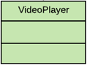
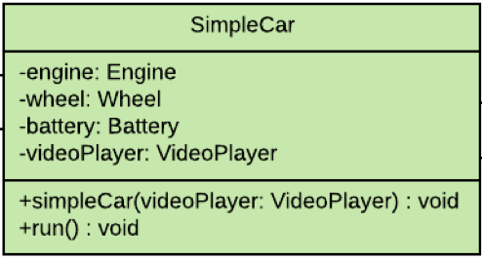
<?xml version="1.0" encoding="UTF-8"?>
<beans xmlns="http://www.springframework.org/schema/beans"
xmlns:xsi="http://www.w3.org/2001/XMLSchema-instance"
xsi:schemaLocation="http://www.springframework.org/schema/beans http://www.springframework.org/schema/beans/spring-beans.xsd">
<bean id="wheel" class="ch.karthi.Wheel"/>
<bean id="engine" class="ch.karthi.Engine"/>
<bean id="battery" class="ch.karthi.Battery"/>
<bean id="videoPlayer" class="ch.karthi.VideoPlayer"/>
<bean id="simpleCar" class="ch.karthi.SimpleCar">
<constructor-arg ref="videoPlayer" name="videoPlayer"/>
<property name="engine" ref="engine" />
<property name="wheel" ref="wheel"/>
<property name="battery" ref="battery"/>
</bean>
</beans>

Slide 41
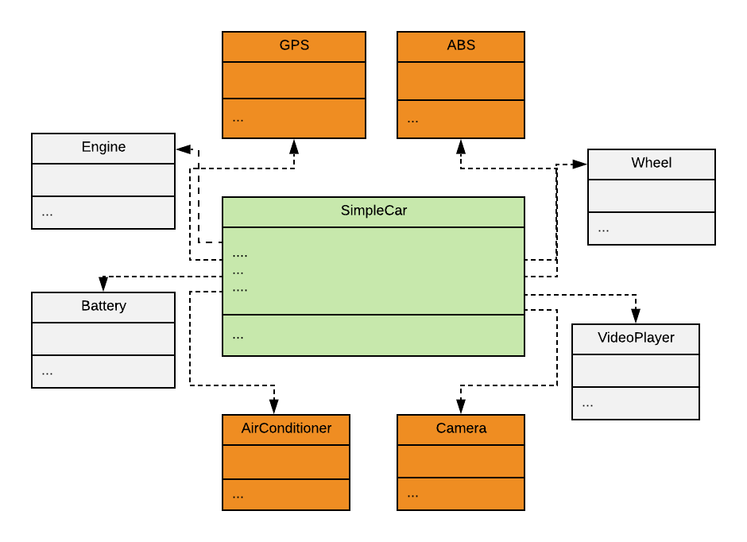
XML Configuration

Slide 42
<?xml version="1.0" encoding="UTF-8"?>
<beans xmlns="http://www.springframework.org/schema/beans"
xmlns:xsi="http://www.w3.org/2001/XMLSchema-instance"
xsi:schemaLocation="http://www.springframework.org/schema/beans http://www.springframework.org/schema/beans/spring-beans.xsd">
<bean id="wheel" class="ch.karthi.Wheel"/>
<bean id="engine" class="ch.karthi.Engine"/>
<bean id="battery" class="ch.karthi.Battery"/>
<bean id="videoPlayer" class="ch.karthi.VideoPlayer"/>
<bean id="gps" class="ch.karthi.GPS"/>
<bean id="camera" class="ch.karthi.Camera"/>
<bean id= … />
...
<bean id="simpleCar" class="ch.karthi.SimpleCar">
<constructor-arg ref="videoPlayer" name="videoPlayer"/>
<property name="engine" ref="engine" />
<property name="wheel" ref="wheel"/>
<property name="battery" ref="battery"/>
<property …..
</bean>
</beans>

Slide 43
<?xml version="1.0" encoding="UTF-8"?>
<beans …
<bean id="wheel" class="ch.karthi.Wheel"/>
<bean id="engine" class="ch.karthi.Engine"/>
<bean id="battery" class="ch.karthi.Battery"/>
<bean id="videoPlayer" class="ch.karthi.VideoPlayer"/>
<bean id="gps" class="ch.karthi.GPS"/>
<bean id="camera" class="ch.karthi.Camera"/>
<bean id= … />
...
Karthi : Hey Spring! Could you please do the bean definitions for me ?
Spring : Yes with pleasure. For that I need some infos too
<bean id="simpleCar" class="ch.karthi.SimpleCar">
…
</bean>
</beans>

Slide 44
<?xml version="1.0" encoding="UTF-8"?>
<beans xmlns="http://www.springframework.org/schema/beans"
xmlns:xsi="http://www.w3.org/2001/XMLSchema-instance"
xsi:schemaLocation=http://www.springframework.org/schema/beans http://www.springframework.org/schema/beans/spring-beans.xsd
http://www.springframework.org/schema/context http://www.springframework.org/schema/context/spring-context.xsd">
<bean id="simpleCar" class="ch.karthi.SimpleCar">
<constructor-arg ref="videoPlayer" name="videoPlayer"/>
<property name="engine" ref="engine" />
<property name="wheel" ref="wheel"/>
<property name="battery" ref="battery"/>
<property …..
</bean>
</beans>

Slide 45

Annotation configuration
@Component
public class Wheel {
Stereotype Annotations
@Component
public class SimpleCar {
@Component
public class Engine {
@Component
public class VideoPlayer {
@Component
public class Battery {

Slide 46
Stereotype Annotations
@Component
@Service
@Repository
@Controller
@RestController
@ControllerAdvice
@Configuration

Slide 47
<?xml version="1.0" encoding="UTF-8"?>
<beans xmlns="http://www.springframework.org/schema/beans"
xmlns:xsi="http://www.w3.org/2001/XMLSchema-instance"
xsi:schemaLocation=http://www.springframework.org/schema/beans http://www.springframework.org/schema/beans/spring-beans.xsd
http://www.springframework.org/schema/context http://www.springframework.org/schema/context/spring-context.xsd">
Karthi : Hey Spring! is it possible to configure these dependencies in java class itself?
Spring : Yes with pleasure. see @Autowired
<bean id="simpleCar" class="ch.karthi.SimpleCar">
<constructor-arg ref="videoPlayer" name="videoPlayer"/>
<property name="engine" ref="engine" />
<property name="wheel" ref="wheel"/>
<property name="battery" ref="battery"/>
<property …..
</bean>
</beans>

Slide 48
@Autowired
@Component
public class SimpleCar {
@Autowired
private Engine engine;
@Autowired
private Wheel wheel;
@Autowired
private Battery battery;
private VideoPlayer videoPlayer;
…
@Autowired
public SimpleCar(VideoPlayer videoPlayer) {
this.videoPlayer = videoPlayer;
}

Slide 49
<?xml version="1.0" encoding="UTF-8"?>
<beans xmlns="http://www.springframework.org/schema/beans"
xmlns:xsi="http://www.w3.org/2001/XMLSchema-instance"
xsi:schemaLocation=http://www.springframework.org/schema/beans http://www.springframework.org/schema/beans/spring-beans.xsd
http://www.springframework.org/schema/context http://www.springframework.org/schema/context/spring-context.xsd">
Karthi : Hey Spring! is it possible to configure this in java class itself?
Spring : Yes with pleasure. Use @ComponentScan and remove this XML File ☺
</beans>

Slide 50
Java Configuration
@ComponentScan("ch.karthi")
public class AppConfig {…}
@Component
public class Engine {…}
<bean id="wheel" class="ch.karthi.Wheel"></bean>
<bean id="engine" class="ch.karthi.Engine"></bean>
…
<bean id="simpleCar" class="ch.karthi.SimpleCar">
<constructor-arg ref="videoPlayer" name="videoPlayer"></constructor-arg>
<property name="engine" ref="engine"></property>
…
</bean>
@Component
public class SimpleCar {
@Autowired
private Engine engine;
}

Slide 51
@Configuration
public class AppConfig {
@Bean
public Battery battery() {
return new Battery();
}
//further bean definitions
@Bean
public SimpleCar simpleCar() {
SimpleCar simpleCar = new SimpleCar(videoPlayer());
simpleCar.setBattery(battery());
// set other properties
return simpleCar;
}
}

Slide 52
Autowiring byName
@Configuration
public class AppConfig {
@Bean
public Battery battery() {
return new Battery();
}
//further bean definitions
@Bean
public SimpleCar simpleCar(Battery battery, Engine engine, Wheel wheel, VideoPlayer videoPlayer){
SimpleCar simpleCar = new SimpleCar(videoPlayer);
simpleCar.setBattery(battery);
// set other properties
return simpleCar;
}
}

Slide 53

IoC Container instantiation & usage

Slide 54
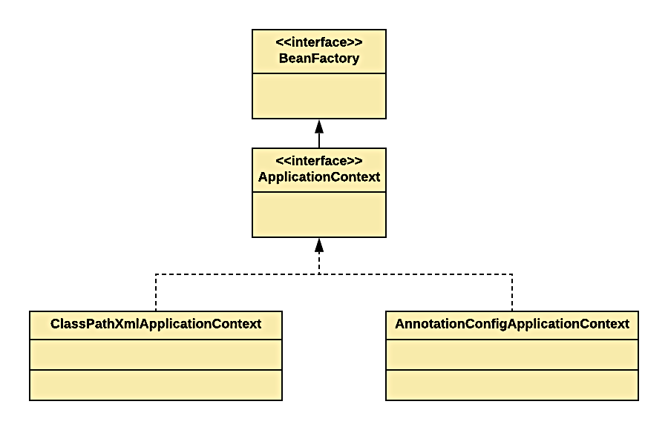
IoC Container in Spring

Slide 55
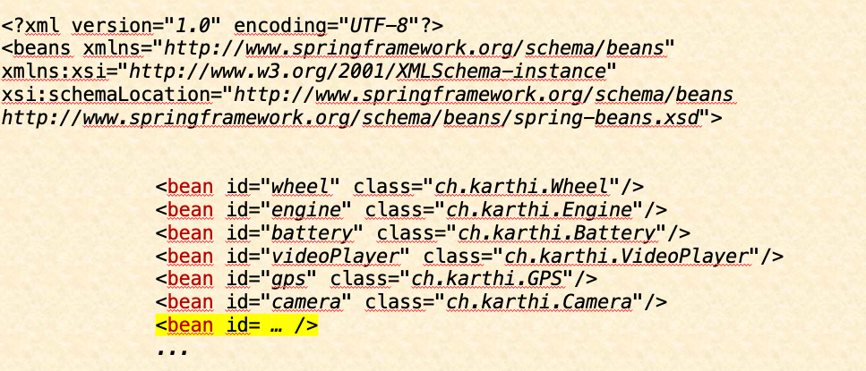
XML
var container = new ClassPathXmlApplicationContext("config.xml");
var simpleCar = container.getBean(SimpleCar.class);
// start the simpleCar

Slide 56
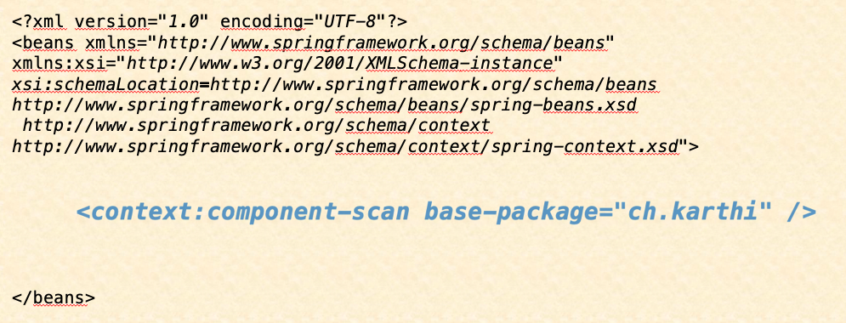
Annotation
var container = new ClassPathXmlApplicationContext("config.xml");
var simpleCar = container.getBean(SimpleCar.class);
// start the simpleCar

Slide 57

Java
@ComponentScan("ch.karthi")
public class AppConfig {…}
var container = new AnnotationConfigApplicationContext(AppConfig.class);
var simpleCar = container.getBean(SimpleCar.class);
// start the simpleCar
@Configuration
public class AppConfig {…}

Slide 58


Dependency Injection Types
Field

Slide 59
Constructor Injection
public SimpleCar(VideoPlayer videoPlayer){
this.videoPlayer = videoPlayer;
}

Slide 60
Constructor Injection
Rule: @Autowired should be present atleast on one constructor, when more than one constructor has been declared.
public SimpleCar() {}
@Autowired
public SimpleCar(VideoPlayer videoPlayer) {
this.videoPlayer = videoPlayer;
}
Exception in thread "main" java.lang.NullPointerException

Slide 61


Constructor Injection
@Autowired
public MyBean(A a) {
@Autowired
public MyBean(A a, B b) {
@Autowired
public MyBean(A a, @Autowired(required=false) B b, …) {
Spring
A
Caused by: org.springframework.beans.factory.NoSuchBeanDefinitionException: No qualifying bean of type 'ch.karthi.B' available: expected at least 1 bean which qualifies as autowire candidate. Dependency annotations: {}

Slide 62
Setter Injection
public class SimpleCar {
private Engine engine;
private Wheel wheel;
@Autowired
public void setEngine(Engine engine) {
this.engine = engine;
}
@Autowired
public void setWheel(Wheel wheel) {
this.wheel = wheel;
}
}

Slide 63
Setter Injection
public class SimpleCar {
@Autowired
private Engine engine;
@Autowired
private Wheel wheel;
}
Field Injection

Slide 64
Constructor or Setter Injection ?
Use constructor for mandatory fields
Use setter for optional fields

Slide 65
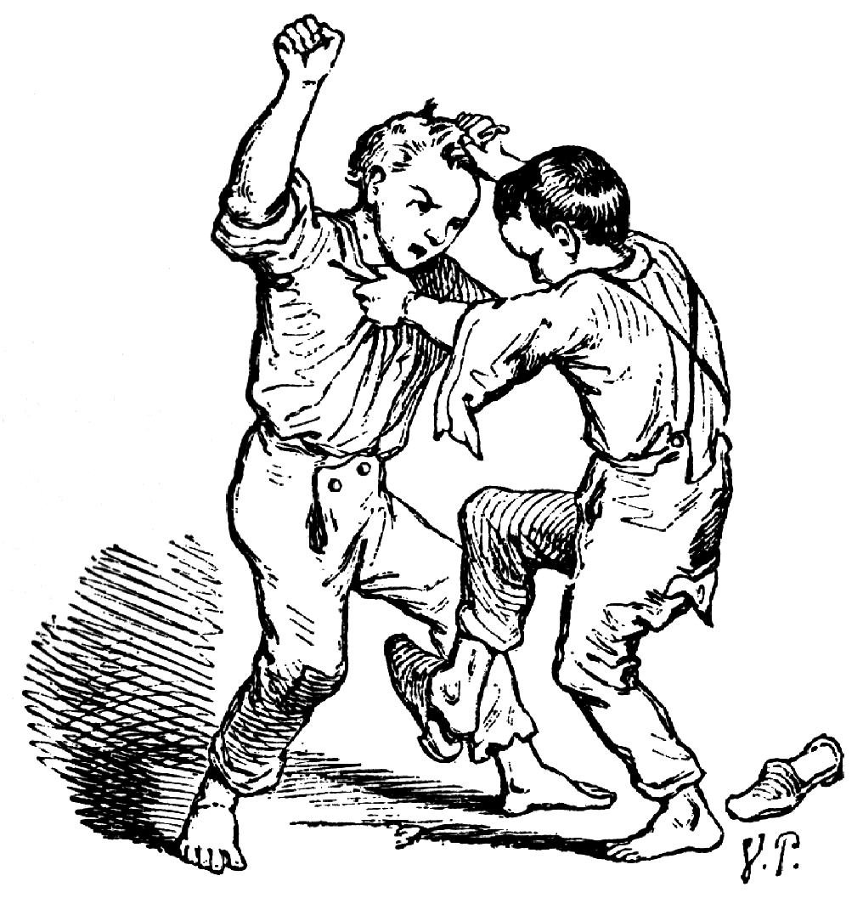
Dependency Resolution in conflicts

Slide 66
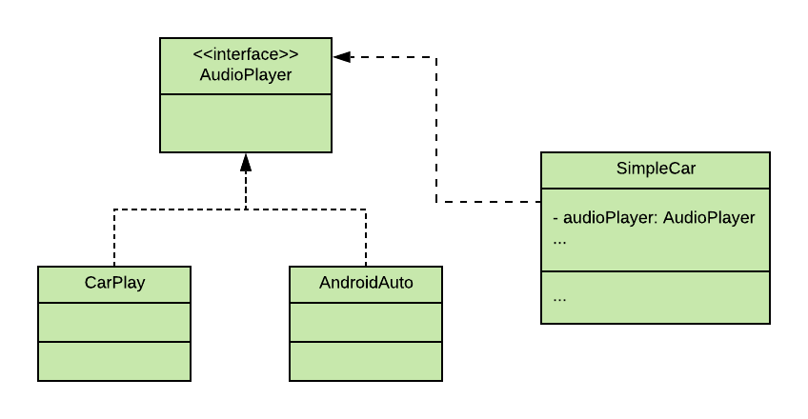
SimpleCar with AudioPlayer

Slide 67

public interface AudioPlayer {...}
@Component
public class AndroidAuto implements AudioPlayer { ... }
@Component
public class CarPlay implements AudioPlayer { ... }
@Component
public class SimpleCar {
@Autowired
private AudioPlayer audioPlayer;
}
org.springframework.beans.factory.NoUniqueBeanDefinitionException: No qualifying bean of type
'ch.karthi.AudioPlayer' available: expected single matching bean but found 2: androidAuto,carPlay

Slide 68
Dependency Resolution Modes
@Primary
@Qualifier
byName
byType

Slide 69
@Primary
public interface AudioPlayer {...}
@Primary
@Component
public class AndroidAuto implements AudioPlayer { ... }
@Primary
@Component
public class CarPlay implements AudioPlayer { ... }
@Component
public class SimpleCar {
@Autowired
private AudioPlayer audioPlayer;
}
org.springframework.beans.factory.NoUniqueBeanDefinitionException: No qualifying bean of type
'ch.karthi.AudioPlayer' available: expected single matching bean but found 2: androidAuto,carPlay

Slide 70
@Qualifier
public interface AudioPlayer {...}
@Component
public class AndroidAuto implements AudioPlayer { ... }
@Component(“carplay”)
public class CarPlay implements AudioPlayer { ... }
@Component
public class SimpleCar {
@Autowired
@Qualifier(“carplay“)
private AudioPlayer audioPlayer;
}
org.springframework.beans.factory.NoUniqueBeanDefinitionException: No qualifying bean of type
'ch.karthi.AudioPlayer' available: expected single matching bean but found 2: androidAuto,carPlay

Slide 71
byName
public interface AudioPlayer {...}
@Component
public class AndroidAuto implements AudioPlayer { ... }
@Component(“carplay”)
public class CarPlay implements AudioPlayer { ... }
@Component
public class SimpleCar {
@Autowired
private AudioPlayer carplay;
}
org.springframework.beans.factory.NoUniqueBeanDefinitionException: No qualifying bean of type
'ch.karthi.AudioPlayer' available: expected single matching bean but found 2: androidAuto,carPlay

Slide 72
byName [fallback]
public interface AudioPlayer {...}
@Component
public class AndroidAuto implements AudioPlayer { ... }
@Component
public class CarPlay implements AudioPlayer { ... }
@Component
public class SimpleCar {
@Autowired
private AudioPlayer carPlay;
}
org.springframework.beans.factory.NoUniqueBeanDefinitionException: No qualifying bean of type
'ch.karthi.AudioPlayer' available: expected single matching bean but found 2: androidAuto,carPlay

Slide 73
byType
public interface AudioPlayer {...}
@Component
public class AndroidAuto implements AudioPlayer { ... }
@Component
public class CarPlay implements AudioPlayer { ... }
@Component
public class SimpleCar {
@Autowired
private CarPlay audioPlayer;
}
org.springframework.beans.factory.NoUniqueBeanDefinitionException: No qualifying bean of type
'ch.karthi.AudioPlayer' available: expected single matching bean but found 2: androidAuto,carPlay

Slide 74

DI of scalar values

Slide 75
@Value
@Component
@PropertySource("wheel.properties")
public class Wheel {
@Value("${radius}")
private double radius = 2.34d;
...
}
@Component
public class Wheel {
private double radius = 2.34d;
...
}
src/main/resources/wheel.properties
radius=4.34
@Value("${radius:4.34}")
private double radius = 2.34d;

Slide 76

Tooling

Slide 77
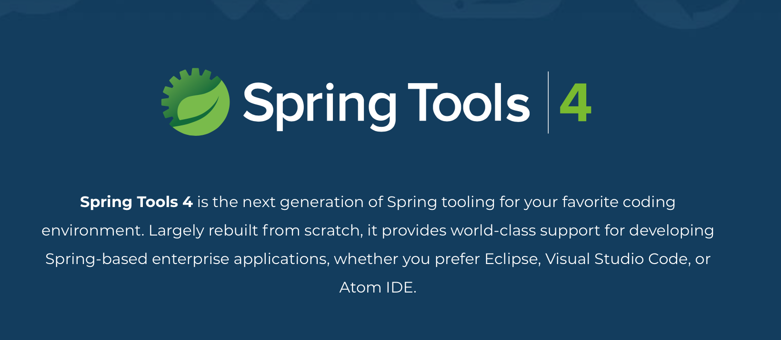
Spring Tool Suite (STS)

Slide 78
STS
Standalone
Plugin
Notes:
Standalone - https://spring.io/tools
Plugin - https://marketplace.eclipse.org/content/spring-tools-4-spring-boot-aka-spring-tool-suite-4

Slide 79
Spring Tool Suite (STS)

Slide 80
STS Demo
bean-graph

Slide 81


Slide 82
Spring Framework II

Slide 83

LAZINESS

Slide 84
Eager initialisation
by default beans are initialised at startup
is good to prevent errors in dependency configuration

Slide 85
Eagerness
@Component
public class AndroidAuto implements AudioPlayer {
public AndroidAuto() {
//check the internet connection (3 secs)
//google account login (2 secs)
//access for microphone and camera (4 secs)
//load the playlists (10 secs)
//cache the playlists (5 secs)
}
}
@Component
public class SimpleCar {
public void run() {
//start battery
//start engine
//start the wheel
}
public void playMusic(){
audioPlayer.playMusic();
}
//setter injected battery,engine,
//wheel & audioplayer
}
var context = new AnnotationConfigApplicationContext(App.class);
SimpleCar simpleCar = context.getBean(SimpleCar.class);
simpleCar.run();
simpleCar.playMusic();

Slide 86
Laziness
@Component
public class SimpleCar {
public void run() {
//start battery
//start engine
//start the wheel
}
public void playMusic(){
if(Objects.isNull(audioPlayer))
audioPlayer = context.getBean(AudioPlayer.class);
audioPlayer.playMusic();
}
//setter injected battery,engine,wheel
}
@Lazy
@Component
public class AndroidAuto implements AudioPlayer {
public AndroidAuto() {
//check the internet connection (3 secs)
//google account login (2 secs)
//access for microphone and camera (4 secs)
//load the playlists (10 secs)
//cache the playlists (5 secs)
}
}

Slide 87


Bean Scopes
Singleton
Prototype

Slide 88

Singleton
getBean(A.class)
Spring
A
A

Slide 89

Singleton
Spring
getBean(A.class)
A
A

Slide 90
Prototype
Spring
getBean(A.class)
A
A

Slide 91
Prototype
Spring
getBean(A.class)
getBean(A.class)
A
A

Slide 92
Scope Configuration
@Scope(scopeName=ConfigurableBeanFactory.SCOPE_PROTOTYPE)
@Scope(scopeName=ConfigurableBeanFactory. SCOPE_SINGLETON)
@Scope(“prototype“)
@Scope(“singleton“)

Slide 93
Bean Lifecycle Callbacks
Initialization callbacks
Destruction callbacks
Notes:
1. Initialisation Callbacks – After the bean‘s constructor has been called by Spring and we still want to do some other kind of initialisation like initialising the filestream, open up a db connection, initialising the AWS connection etc, which are not part of the bean construction but we still want to make sure these initialisation before the bean is put into use.

Slide 94
Initialization callbacks
InitializingBean
initMethod in @Bean
@PostConstruct

Slide 95
@PostConstruct
@Component
public class VideoPlayer {
private AsmiqAcademyStream asmiqAcademyStream;
private YoutubeStream youtubeStream;
private String youtubeApiKey = "y7k8nd9d92dl2m";
private String asmiqAcademyApiKey = "y7k8nd9d92dl2m";
@PostConstruct
private void initStreams() {
asmiqAcademyStream = AsmiqAcademyStream.builder().withApiKey(asmiqAcademyApiKey).build();
youtubeStream = YoutubeStream.builder().withApiKey(youtubeApiKey).build();
}
}

Slide 96
InitializingBean
@Component
public class VideoPlayer implements InitializingBean{
private AsmiqAcademyStream asmiqAcademyStream;
private YoutubeStream youtubeStream;
private String youtubeApiKey = "y7k8nd9d92dl2m";
private String asmiqAcademyApiKey = "y7k8nd9d92dl2m";
@Override
public void afterPropertiesSet() throws Exception {
initStreams();
}
private void initStreams() {
asmiqAcademyStream = AsmiqAcademyStream.builder().withApiKey(asmiqAcademyApiKey).build();
youtubeStream = YoutubeStream.builder().withApiKey(youtubeApiKey).build();
}
}

Slide 97
initMethod in @Bean
@Component
public class VideoPlayer {
private AsmiqAcademyStream asmiqAcademyStream;
private YoutubeStream youtubeStream;
private String youtubeApiKey = "y7k8nd9d92dl2m";
private String asmiqAcademyApiKey = "y7k8nd9d92dl2m“;
private void initStreams() {
asmiqAcademyStream = AsmiqAcademyStream.builder().withApiKey(asmiqAcademyApiKey).build();
youtubeStream = YoutubeStream.builder().withApiKey(youtubeApiKey).build();
}
}
@Configuration
public class AppConfig {
@Bean(initMethod="initStreams")
public VideoPlayer videoPlayer() {
return new VideoPlayer();
}
}

Slide 98

Initialization callbacks precedence
PostConstruct
InitializingBean
initMethod in @Bean

Slide 99
Destruction callbacks
DisposableBean
destroyMethod in @Bean
@Predestroy

Slide 100
@Predestroy
@Component
public class VideoPlayer {
private AsmiqAcademyStream asmiqAcademyStream;
private YoutubeStream youtubeStream;
private String youtubeApiKey = "y7k8nd9d92dl2m";
private String asmiqAcademyApiKey = "y7k8nd9d92dl2m";
@PreDestroy
private void signOffStreams() {
asmiqAcademyStream.signOff();
youtubeStream.signOff();
}
public void run() {
// start any of the stream
}
}

Slide 101
DisposableBean
@Component
public class VideoPlayer implements DisposableBean{
private AsmiqAcademyStream asmiqAcademyStream;
private YoutubeStream youtubeStream;
private String youtubeApiKey = "y7k8nd9d92dl2m";
private String asmiqAcademyApiKey = "y7k8nd9d92dl2m";
@Override
public void destroy(){
signOffStreams ();
}
private void signOffStreams() {
asmiqAcademyStream.signOff();
youtubeStream.signOff();
}
}

Slide 102
destroyMethod in @Bean
@Component
public class VideoPlayer {
private AsmiqAcademyStream asmiqAcademyStream;
private YoutubeStream youtubeStream;
private String youtubeApiKey = "y7k8nd9d92dl2m";
private String asmiqAcademyApiKey = "y7k8nd9d92dl2m";
private void signOffStreams() {
asmiqAcademyStream.signOff();
youtubeStream.signOff();
}
public void run() {
// start any of the stream
}
}
@Configuration
public class AppConfig {
@Bean(destroyMethod="signOffStreams")
public VideoPlayer videoPlayer() {
return new VideoPlayer();
}
}

Slide 103
Destruction callbacks precedence
PreDestroy
DisposableBean
destroyMethod in @Bean

Slide 104

Web-MVC
"Dieses Foto" von Unbekannter Autor ist lizenziert gemäß CC BY-NC

Slide 105
Refresh …
Servlet
Java program that runs on server.
Servlet container
A software that provides runtime for the servlets. (eg) Tomcat, Jetty

Slide 106
Servlet – An example
@Override
protected void doGet(HttpServletRequest request, HttpServletResponse response) throws ServletException, IOException {
response.setContentType("text/html");
request.authenticate(response);
PrintWriter writer = response.getWriter();
writer.println("<html>");
writer.println("<head>");
writer.println("this is simple serlvet example");
writer.println("</head>");
writer.println("<body>");
writer.println("Hello HBT :-)");
writer.println("</body>");
writer.println("</html>");
}

Slide 107
MVC
Model
View
Controller

Slide 108

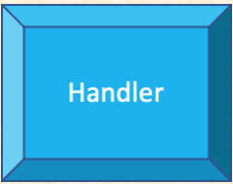
FrontController
Dispatcher-
Servlet
ViewResolver

Slide 109
Handler
Controller
Get
Put
Post
Delete

Slide 110
Controller
@Controller
@RestController

Slide 111
@Controller
@Controller
public class ShoppingBasket{
@RequestMapping(name="/items”, method=RequestMethod.GET)
public List<ShoppingItem> items(){
//return the shopping lists
}
}

Slide 112
RequestMapping Methods
public enum RequestMethod {
GET, HEAD, POST, PUT, PATCH, DELETE, OPTIONS, TRACE
}

Slide 113
@RestController
@RestController
public class ShoppingBasket{
@GetMapping(name="/items”)
public List<ShoppingItem> items(){
//return the shopping lists
}
}

Slide 114
Mapping Methods
@PostMapping
@PutMapping
@DeleteMapping
@PatchMapping

Slide 115
Spring Boot I

